Slide 1
EXCEL HAKATHONS
PREPARED BY: KUMAR ANKIT
Topic : U.S Financial Retail Dataset
BATCH : DS20NOV01

Slide 2
Problem statements for U.S RETAIL SERVICE . 1.Yearly sales and profit for every segment. 2.Monthly gross sales along with the profit 3. Country wise product sales 4.Total sales with profit percentage when discount was available 5. Segment wise profit for all products for all years 6. Sum of sales w.r.t to total sum of cogs in different months 7.country wise product profit .. 8. Max & Min profit based on different countries and product 9. Quarterly sales based on manufacturing price 10..Total sales on different segment

Slide 3
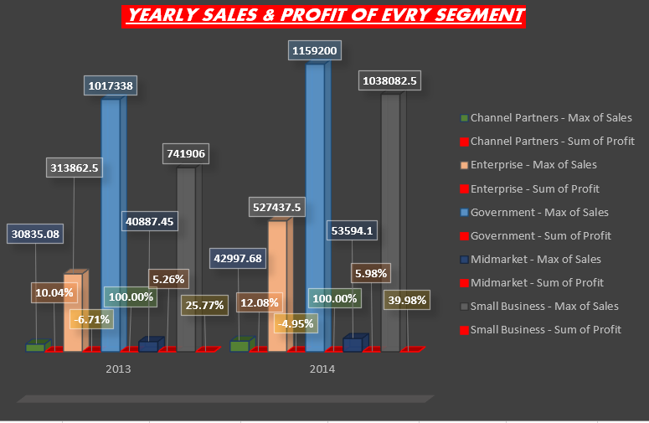
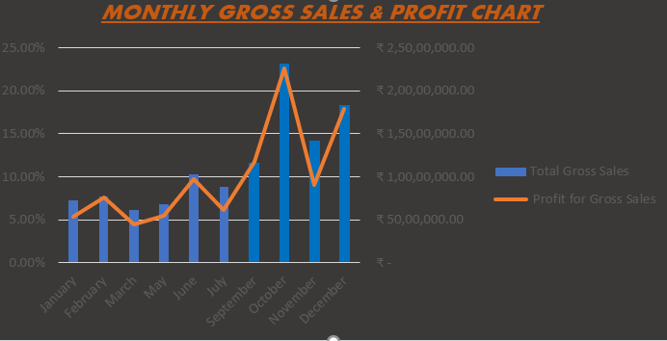
IN this first data chart YEARLY SALES & PROFIT OF EVERY SEGMENT IS shown. This chart describes every segment and their maximum sales being done in two years along with the total profit percentage that every segment is doing over those years .where all colours In red indicates the total profit percentage shown with with the data labels itself. Along with every segment is being coloured with different colours as given in description for every segment. .. In this second chart MONTHLY GROSS SALES & THEIR PROFIT HAS BEEN SHOWN all over the months with all blue bars indicates the total gross sales and ORANGE with line in the bars shows how the profit is behaving on the basis of the monthly gross sales. In this the profit percentage is shown in the left side ,and total gross sales is being shown in right

Slide 4
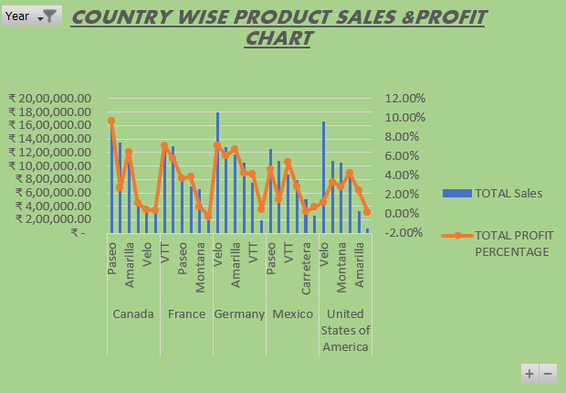
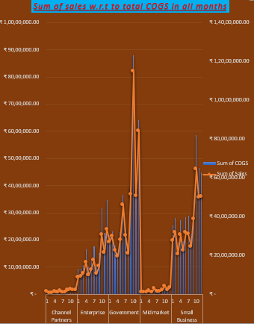
The first chart is COUNTRY WSE PRODUCT SALES & PROFIT . Here deep focous has been done to register which country is making large no. of sales and profit in which of their products . As for every country every product is being specified . All the blue bars that is shown is the total sales , and the orange line on the blue bars is indicating the profit which is gradually rising or decreasing according to their total sales. In this chart profit percentage is shown in right side and the total sales is shown in left. The second chart SUM OF SALES W.R.T TO THE TOTAL SUM OF COGS IN ALL MONTH FOR ALL SEGMENT . This chart will help us to understand what is our total sales with resect to the total cogs that is being produced over all months for all segment . It will help to understand and then we can improve on hose areas where the sale line is gradually downwards in order to increase the sales and profit level as well.

Slide 5
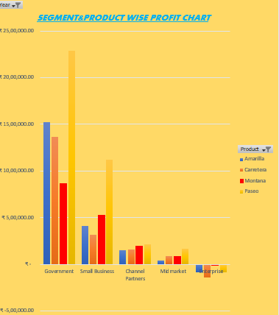
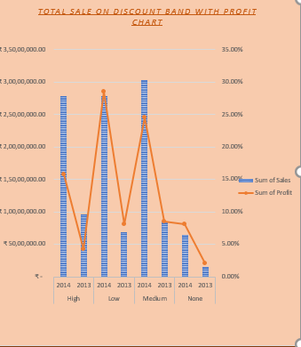
HERE ARE TWO MORE CHARTS : in first chart ‘SEGMENT & PRODUCT WISE PROFIT CHART ‘ different segment with all the product is being given with their sum of profits. Here which product has better sales in which segment .here enterprise have quite low profit as compared to government sector …. Here in the second chart i.e TOTAL SALES ON DISCOUNT BAND WITH PROFIT chart ,here I want to show what profit I made when discount was low ,high, medium or their was no discount ,similarly here bars in blue indicates the total sum of sales and the line with orange on the blue bars represent the profit percentage

Slide 6
CONCLUSION: for every project conclusions matters a lot .my project and presentation have also some conclusions conclusion gives the basic brief for whole project and I would like to do as well . hence I would give rest to my project by giving a final conclusion on my topic : US RETAIL SERVICE DATA SET FOR THE YEAR 2013-2014 as my power point slides are the brief related to the problem statement of the growth of the organization of while doing analysis on that data set there are all problem statement shown charts .. For more it may be referred to dashboard . With that problem statement every chart is prepared and shown in presentation and dashboard. While doing analysis I found which segment is performing good . Which sector have better sales in which country what are my total product sales with the profit . What are the yearly sales and profit chart for every segment country wise product sales has been registered to see in which country we have better which product has better sales . What are the top sales when discount was high. Medium . Low or also when there was no profit . The data set is also being analyzed with what are the monthly gross sales with profit . ………………………………………………………………………….THANKU……………………………………………EXCEL HAKATHONE …………………………………………………………………………………………………………………………………………..

